Slide 1
Charlotte Lennox: The Lady’s Museum and “Harriot & Sophia”
Dr. Karenza Sutton-Bennett ©

Slide 2
Agenda:
Review: The Lady’s Museum
Introduction to “Harriot & Sophia”
Textual representations of education
Activity: analyzing visual representation of H&S
Discussion
Workshop Activity

Slide 3
Charlotte Lennox
Charlotte Ramsay born in 1730
Actress, playwright, novelist, periodicalist & translator
Married Alexander Lennox
Died in 1804

Slide 4
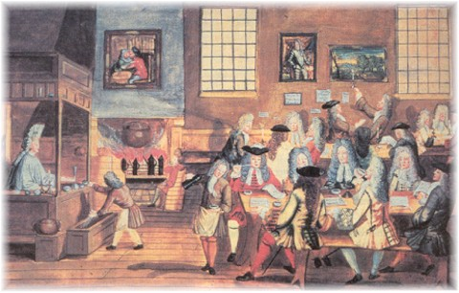
The Rise of Periodicals & Newspapers
Reasons behind
their popularity:
Public accessibility
Periodicity
Timeliness
Universality
Writing 6000 yrs * Moveable Type 500 yrs * Periodicals 400 yrs

Slide 5
Girl’s Education in Eighteenth Century
Formal:
Informal:
Boarding Schools
Arts
Aesthetics
Amusements
Private Tutor
Parent/Guardian
Self-directed or guided Reading
* These options were only for upper-class & middle-class girls

Slide 6
Representations of Education:
Trifler → fondness for reading, brother tutors her (informal)
Harriot → attending boarding school (formal)
Sophia → fondness for reading, Mr. Herbert tutors her (informal)
Dolly → father educates his daughters (practical)

Slide 7
Key Term:
Sentimental → 1. Of persons, their dispositions and actions: Characterized by sentiment. Originally in favourable sense: Characterized by or exhibiting refined and elevated feeling. In later use: Addicted to indulgence in superficial emotion; apt to be swayed by sentiment.
2. Of literary compositions (occasionally of music or other art): Appealing to sentiment; expressive of the tender emotions, esp. those of love.

Slide 8
A Tale of Two Sisters:
“[w]hile Harriot was receiving the improvement of a polite education, Sophia was left to form herself as well as she could; happily for her a just taste and solid judgment supplied the place of teachers, precepts, and example. The hours that Harriot wasted in dress, company, and gay amusements, were by Sophia devoted to reading” (18)

Slide 9
Question of Morals or Education?
Harriot: “for, as I read in one of your books just now, Virtue would not go so far, if pride did not bear her company” (248)
Sophia: “you might also have read [...] that no woman is envious of another’s virtue who is conscious of her own” (248)

Slide 10
Images of Harriot & Sophia

Slide 11
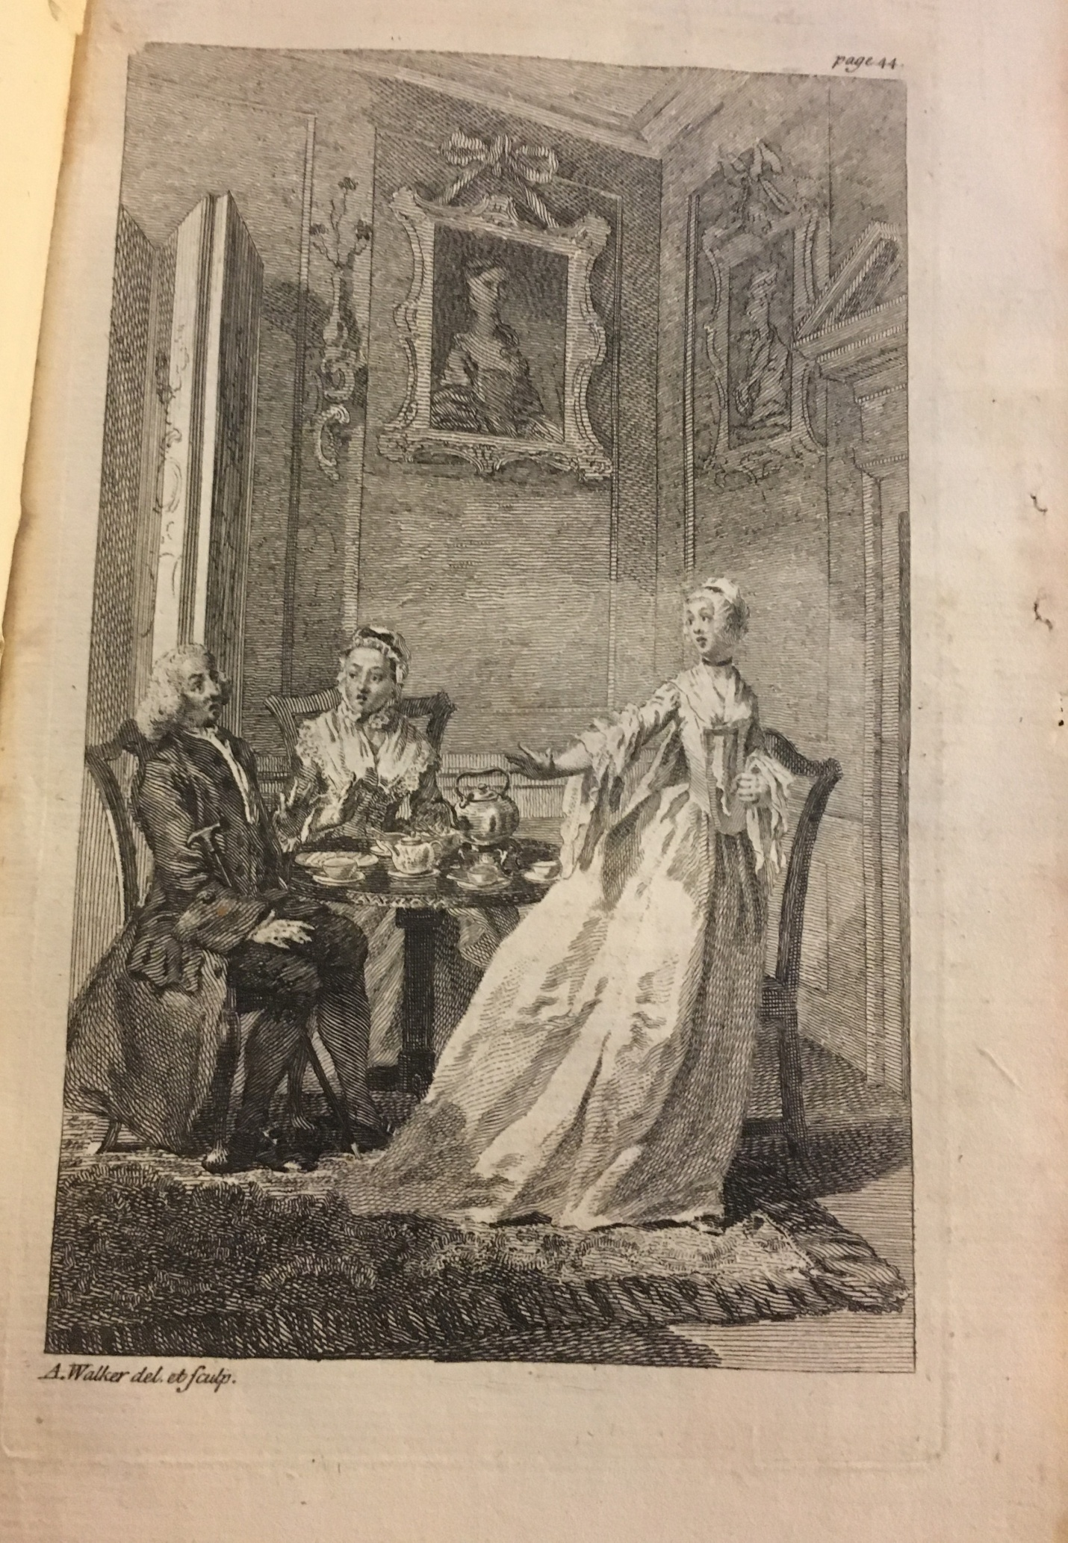
What are your first impressions of Harriot?

Slide 12
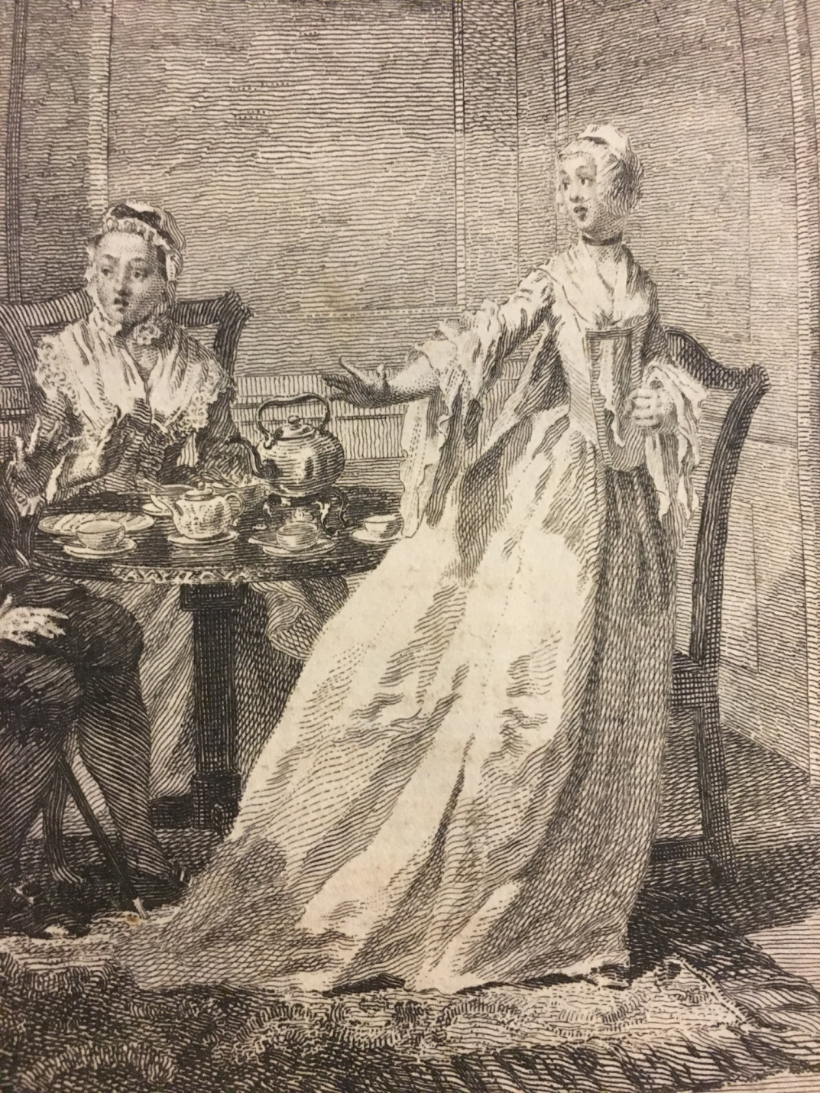
What do think about her attire? What does it signify?

Slide 13
“Harriot, no longer able to suppress her rage and envy, was thrown so far off her guard as to burst into tears. ‘I cannot bear to be thus insulted, cried she; and I declare if Sir Charles is permitted to go on with his foolery with that vain girl, I will quit the house.” (44)

Slide 14
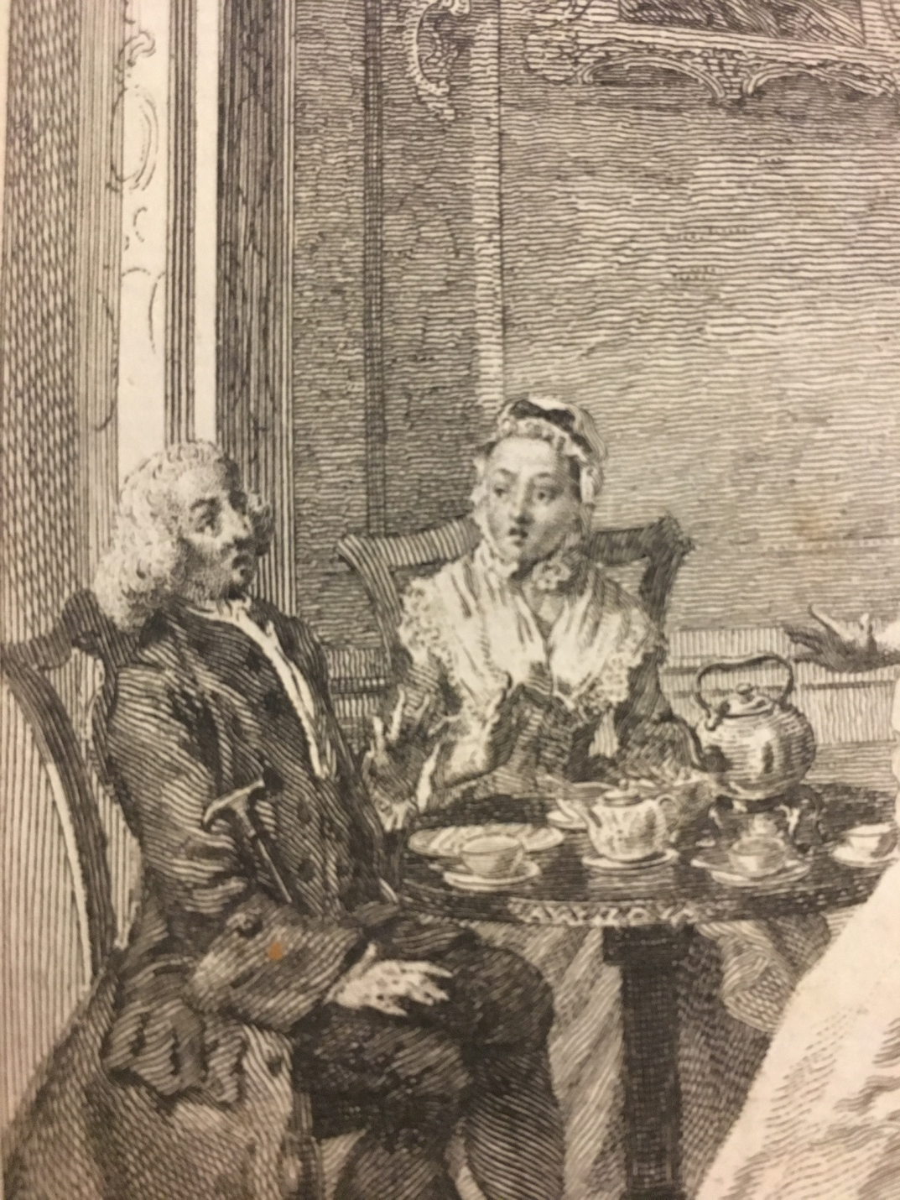
“I am speaking to my mother, sir, replied Harriot, with a contemptuous frown; depend upon it Madam, pursued she, that I will not stay to be sacrificed to Mr. Herbert’s favorite – either she shall be forbid to give Sir Charles any encouragement, who after all, is only laughing at her, or I will leave the house.” (44).
Notes:
Figure 2. “Harriot” The Lady’s Museum. Vol 1. (1760) ECCO

Slide 15
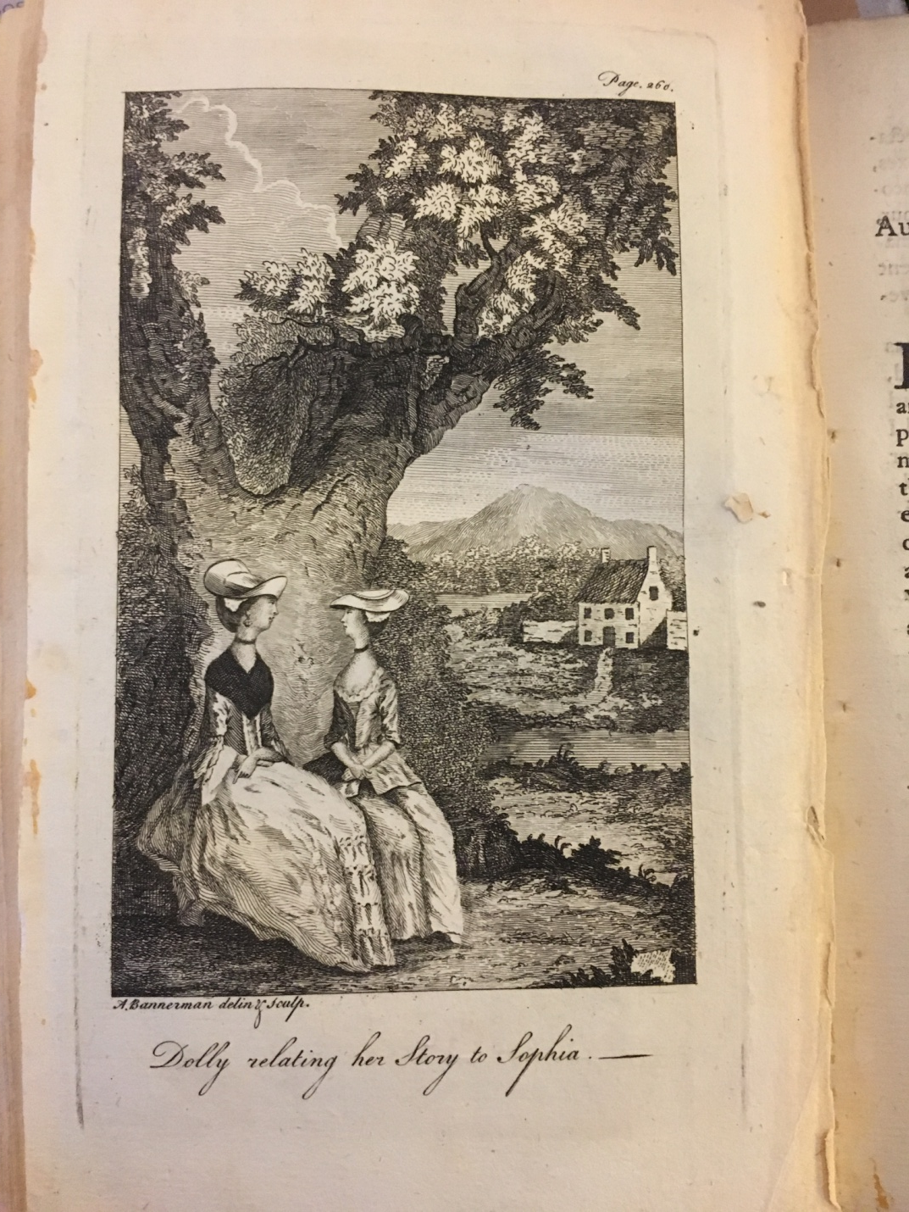
What is your first impression of the image of Sophia & Dolly?

Slide 16
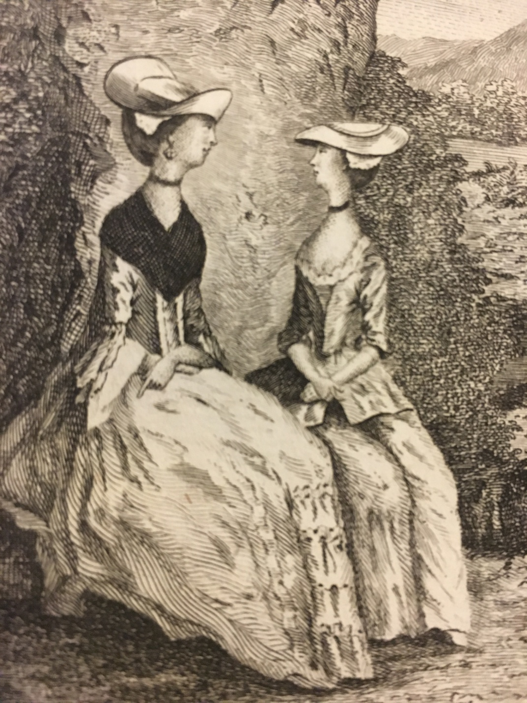
How does Sophia’s dress compare to Harriot’s?
Notes:
Figure 3. “Sophia” The Lady’s Museum. Vol 1. (1760) ECCO

Slide 17
“Come, my dear, said Sophia (…), let us sit down here, we shall not be called to supper yet, you have time enough to give me some account of this young man, whom I should be glad to find worthy of you: tell me how your acquaintance began, what are your father’s reasons for forbidding your correspondence”(260)
Notes:
Figure 3. “Sophia” The Lady’s Museum. Vol 1. (1760) ECCO

Slide 18
Discussion Questions:
What are the overall differences between the sisters (represented in these two images)?
Do you think the images are a necessary component to the story, and if so why?

